Slide 1

El contexto COVID-19 en la Región Amazónica
Carlos Arósquipa
Programa Subregional para América del Sur
Organización Panamericana de la Salud/Organización Mundial de la Salud
23 de Julio 2020

Slide 2
Panorama Global
1
Panorama Regional
2
Panorama en la Cuenca amazónica
Tabla de contenidos
3
Pasos a seguir
4

Slide 3
COVID-19: Panorama global
Burden of cumulative cases among six WHO regions. As of 16 July 2020.
>13.5 Million
584,940
Cases
Deaths
32%
EMRO
PAHO
9%
47%
4%
2%
6%
SEARO
AFRO
WPRO
EURO

Slide 4
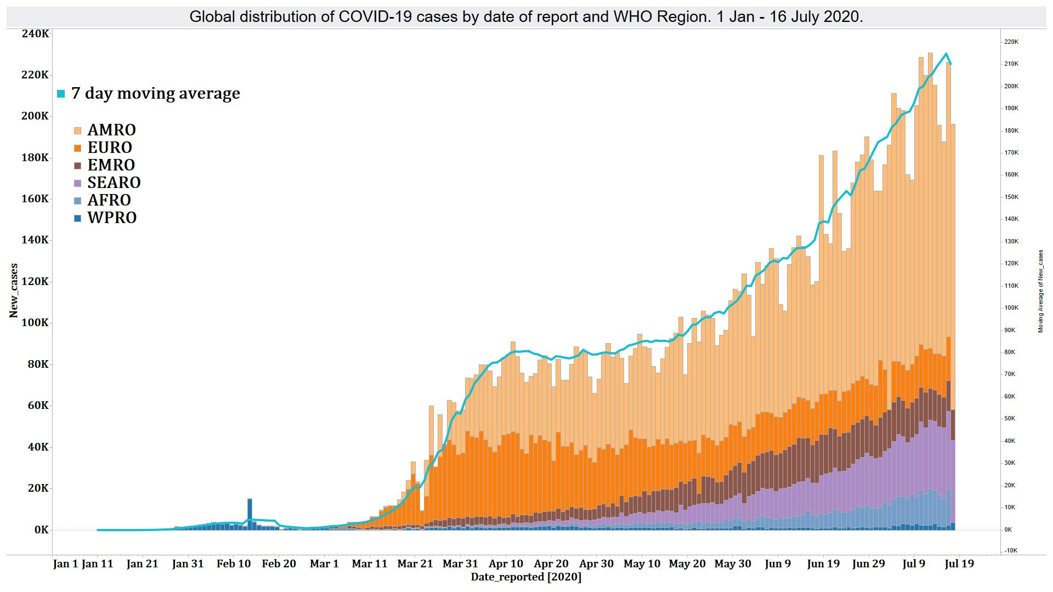
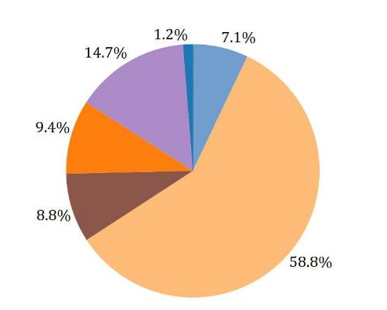
Panorama global- Casos
+1.5 Million
Cases
+12.3%
Notes:
1,471,877 additional cases for a relative increase of 12.3% compared to last week.
Among new cases reported in the past week, 59% of the cases were from AMRO, 15% from SEARO, 9% from EMRO, 9.4% from EURO, 7% from AFRO, and 1.2% from WPRO.

Slide 5
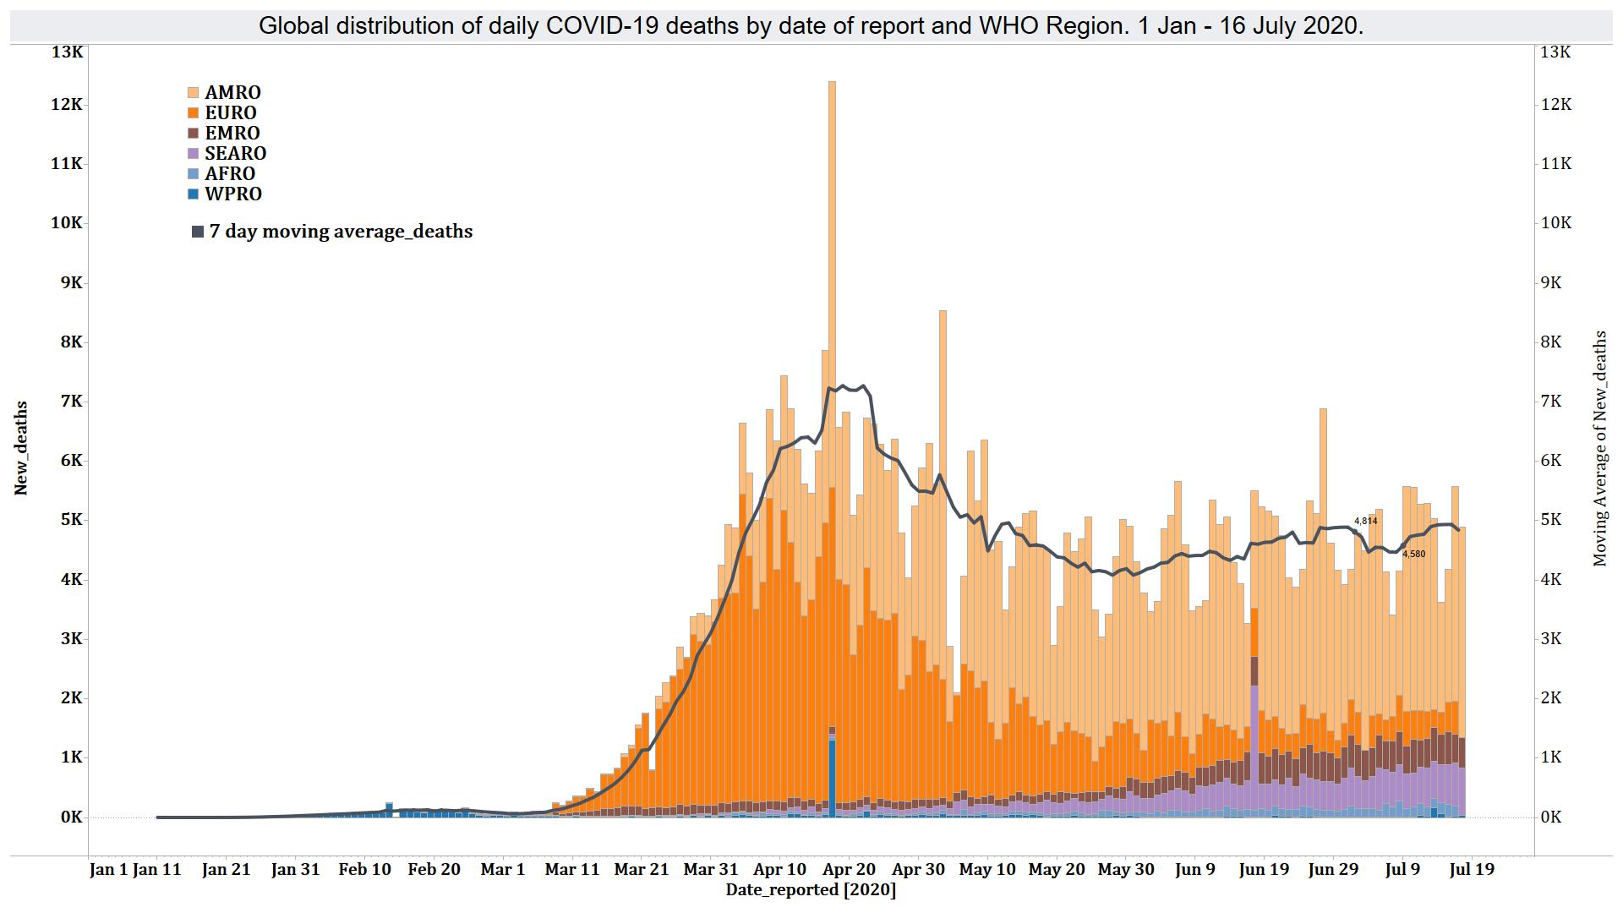
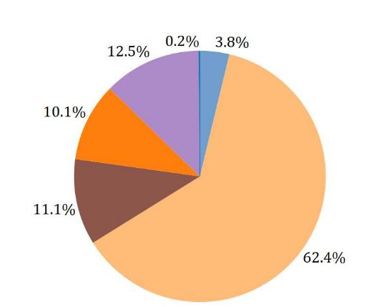
Panorama Global- Muertes
+33,892
Deaths
+6%
Notes:
33,892 additional deaths for a 6% relative increase compared to the previous week
Among the new deaths reported this past week, 62.4% were from AMRO, 12.5% from SEARO, 11.1% from EMRO, 10.1% from EURO, 3.8% from AFRO, and 0.2% from WPRO.

Slide 6
Region de las Americas

Slide 7
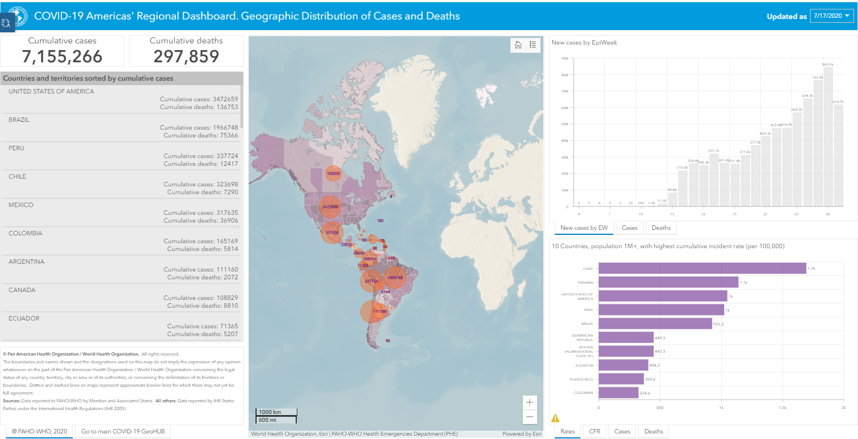
https://paho-covid19-response-who.hub.arcgis.com/

Slide 8
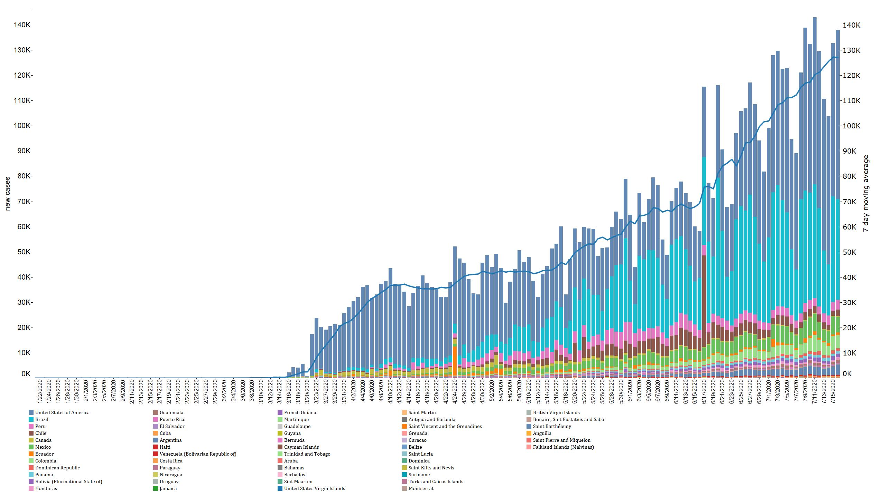
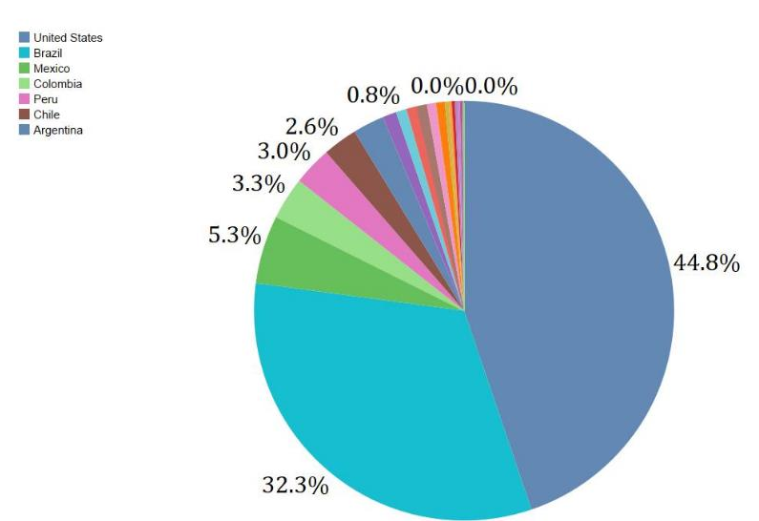
Distribution of new COVID-19 cases by date of report and country. Region of the Americas. 21 Jan – 16 July 2020
+>890,000
(+14%)
Cases
Date of Report
Notes:
In the region of the Americas, COVID-19 cases continue to occur at a rapid pace in many countries and territories.
890,130 additional cases were reported in the past week, a 14% relative increase compared to the previous week.
Of the new cases, 45% were from the US, 32% from Brazil, and 5.3% from Mexico.

Slide 9
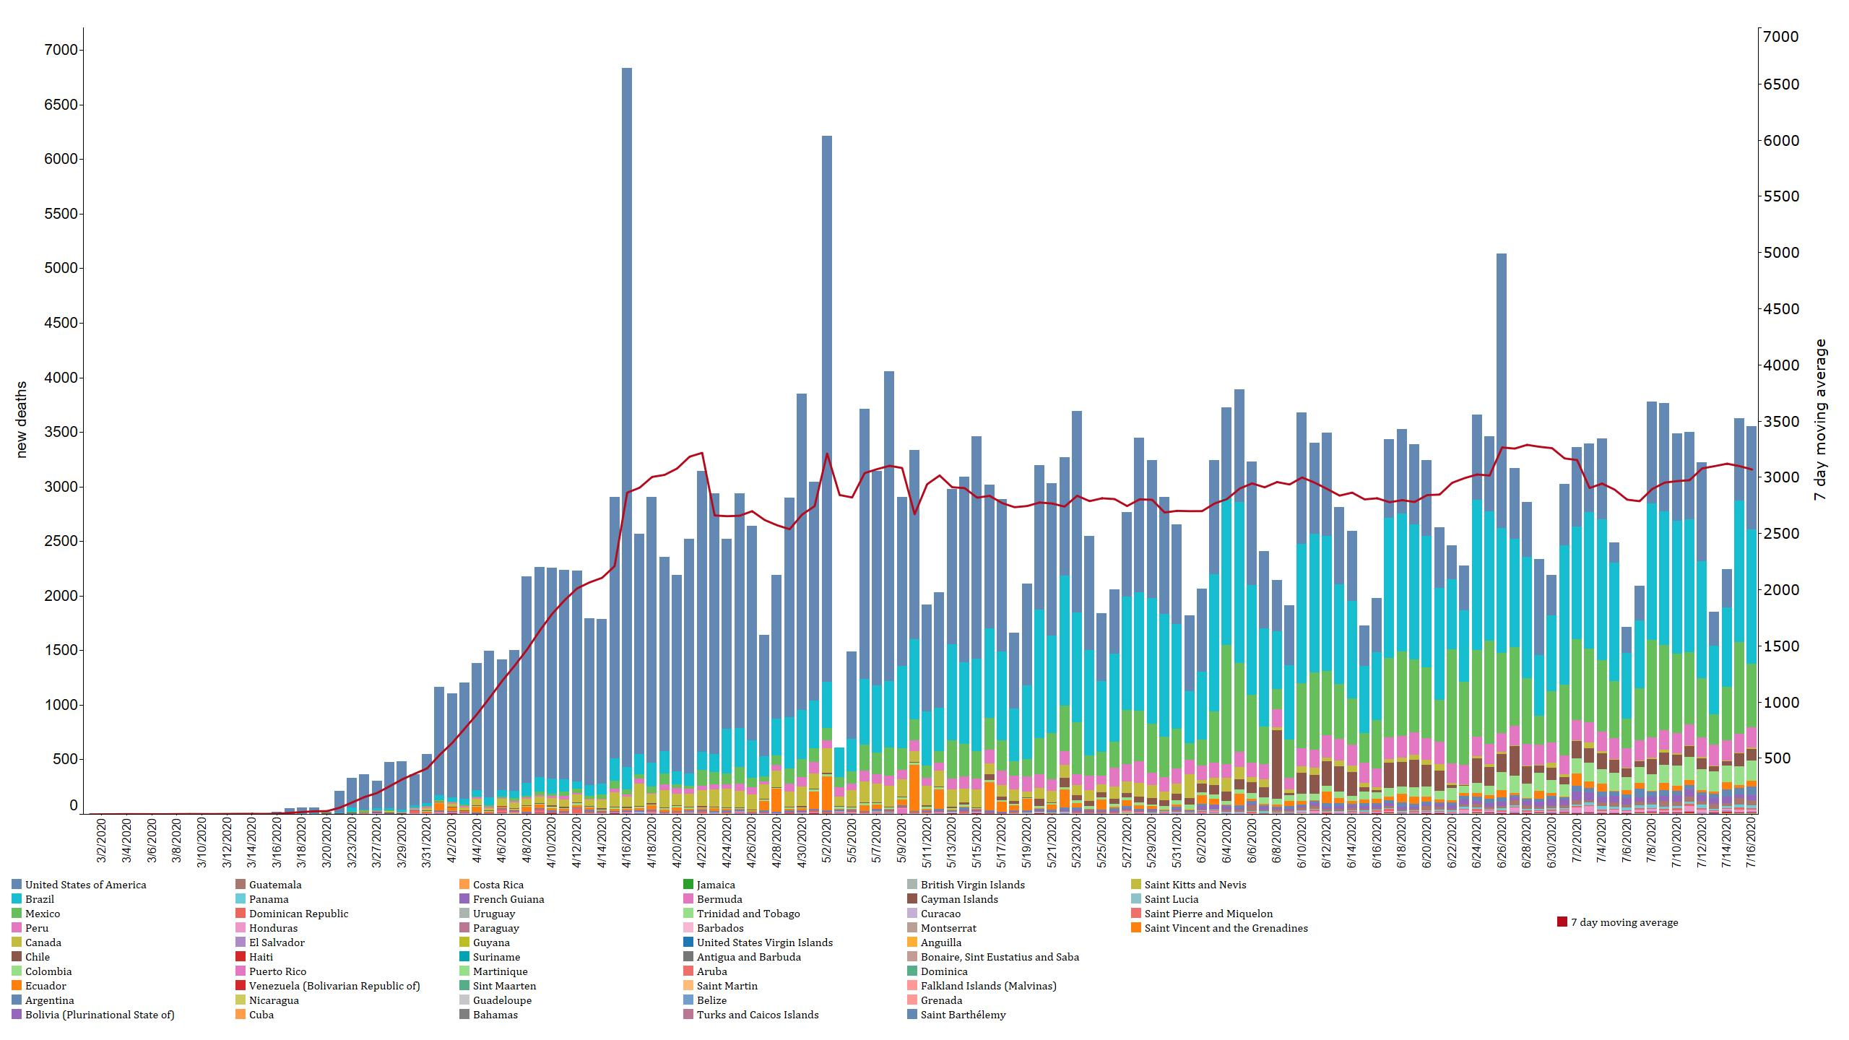
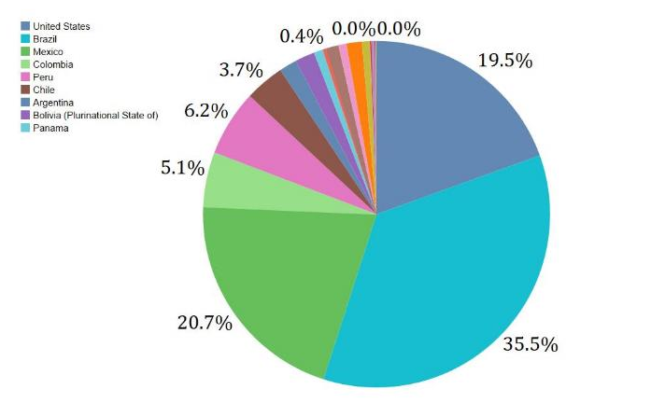
Distribution of new COVID-19 deaths by date of report and country. Region of the Americas. 1 March – 16 July 2020
+21,485
(+7.7%)
Deaths
Date of Report
Notes:
The epi-curve of deaths should be interpreted with caution due to numerous biases such as delays in reporting, differences in case definitions being used, not enough testing, and deaths that occur outside hospital premises such as at home and nursing homes.
21,485 additional deaths, 7.7 % relative increase compared to the previous week.
Of the new deaths, 36% were from Brazil, 21% from Mexico and 20% from the United States of America.

Slide 10
Cuenca Amazónica

Slide 11
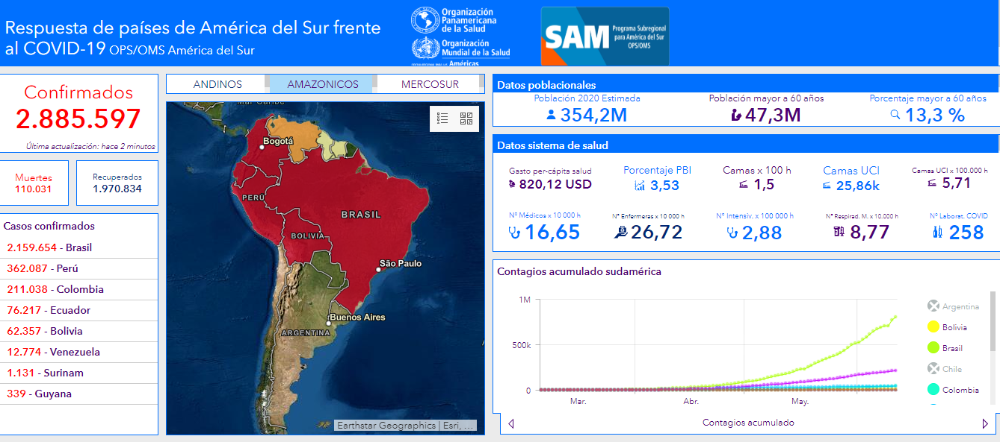
Dashboard de COVID en América del Sur OPS/OMS SAM

Slide 12
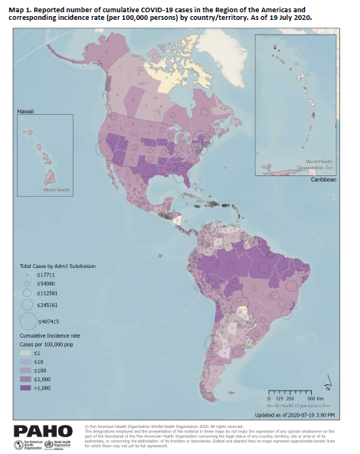
El epicentro de la pandemia ahora esta en las Américas
Dentro de las Américas, los países de la cuenca amazónica son los mas golpeados por la epidemia.
Dentro de la cuenca amazónica, son las poblaciones indígenas los mas afectados.

Slide 13
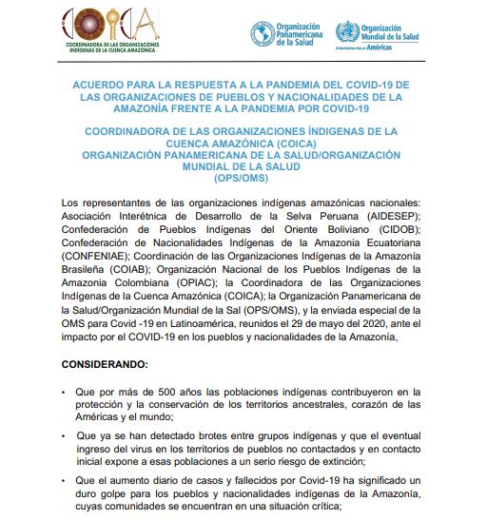
Los pueblos indígenas amazónicos están siendo fuertemente golpeados por la pandemia
COICA y la OPS piden a los países “fortalecer la atención en los servicios de salud de la Amazonía, con la dotación de recursos humanos, insumos y dispositivos médicos, incluidas las pruebas y tratamientos y vacunas para la COVID-19 cuando estas estén disponibles”, con especial énfasis en los pueblos con aislamiento voluntario.

Slide 14
Próximos pasos

Slide 15
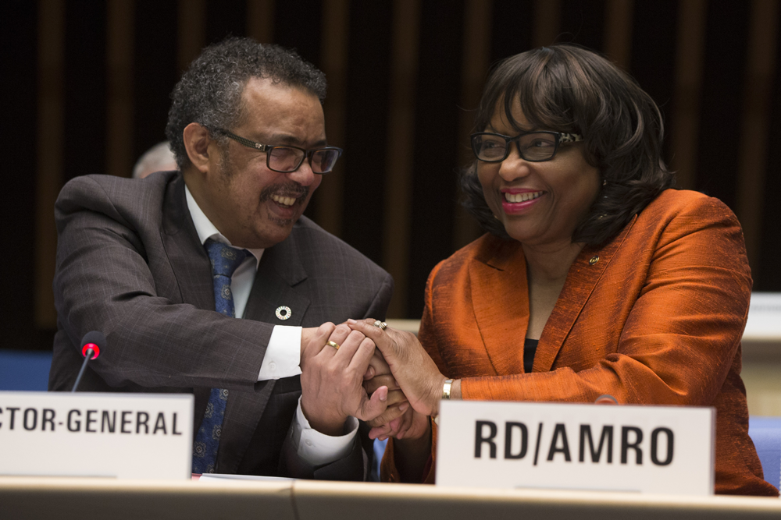
Tenemos la oportunidad de aprender de la experiencia de Italia frente a la pandemia
Impulsar fuertemente la cooperación horizontal entre los países amazónicos
Atender y poner especial énfasis en poblaciones vulnerables como las pueblos indígenas amazónicos
Tendremos una serie de seminarios web OPS y OTCA que profundizarán la problemática de la pandemia en la cuenca amazónica

Slide 16
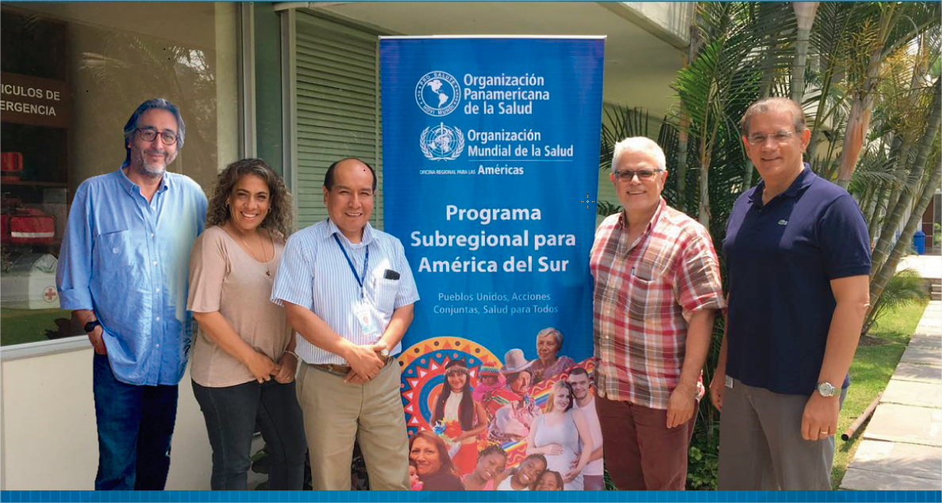
Muchas gracias
https://www.paho.org/es/programa-subregional-para-america-sur
arosquipac@paho.org

